Slide 1
Name: Form:
SCIENCE FUNDAMENTAL KNOWLEDGE QUIZ BOOKLET
Key Stage 4
Paper 1
Biology

Slide 2
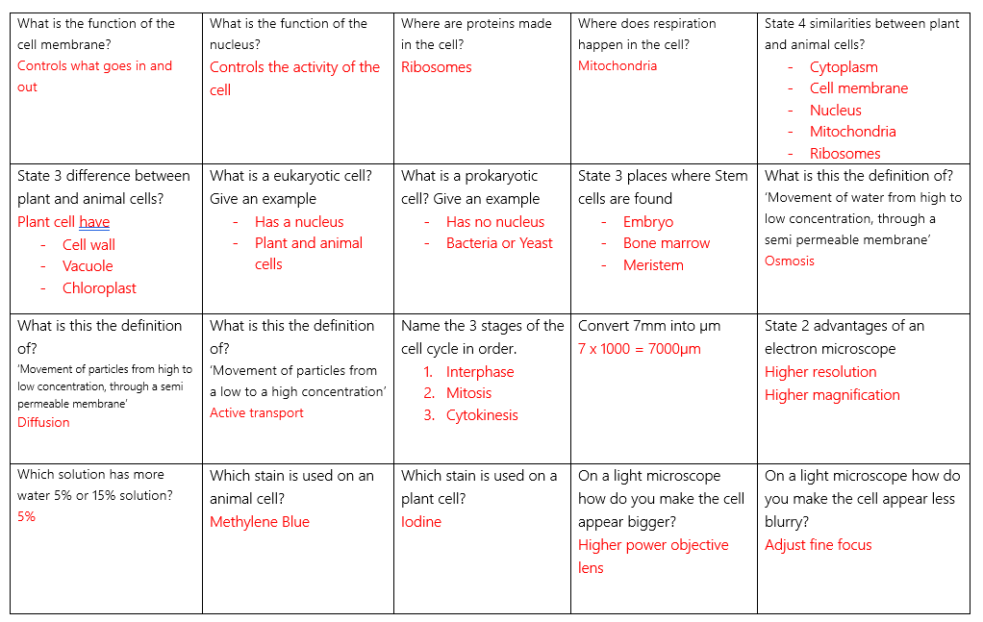
B1 – Cells

Slide 3
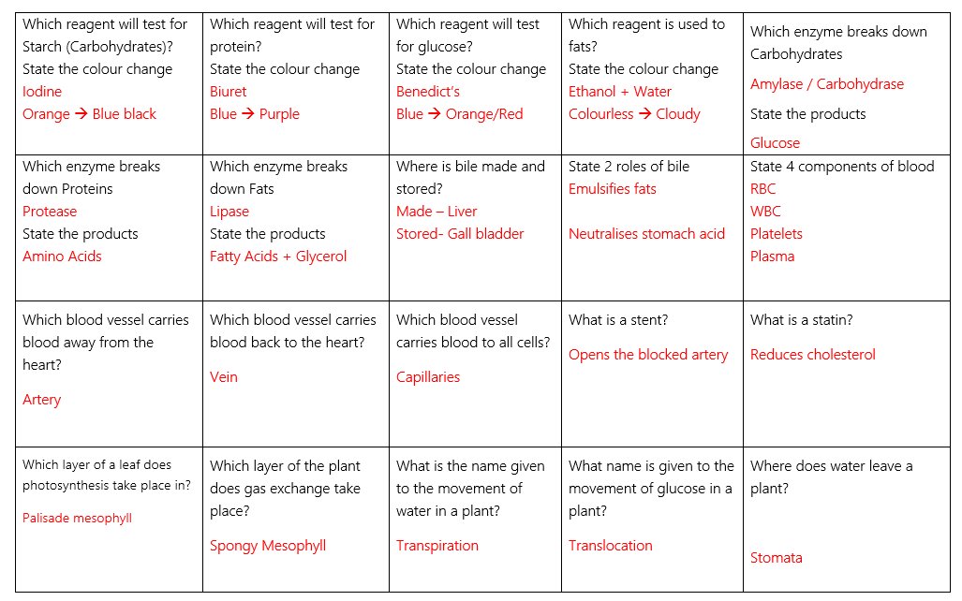
B2 – Organisation

Slide 4
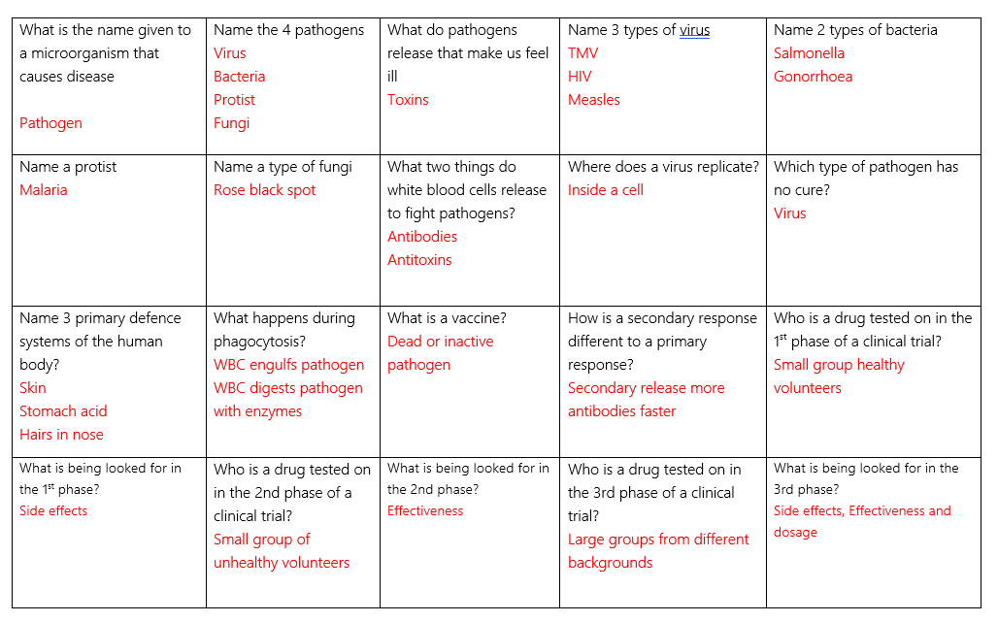
B3 – Infection and response

Slide 5
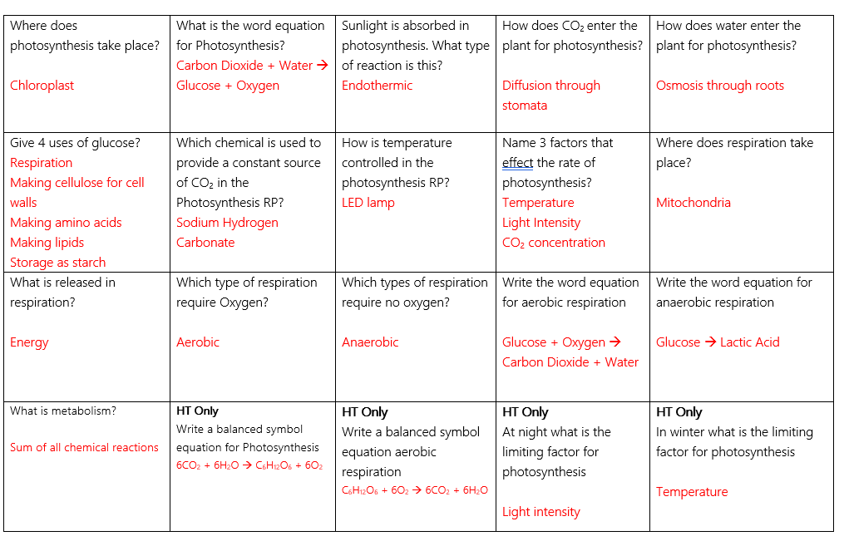
B4 – Bioenergetics

